Slide 1

Social Inequality
Ms. Kauser Malik
Lecturer (Psychology)
Sciences and Humanities

Slide 2
Learning Outcomes
1. Social stratification
2. Global stratification: Class, Caste (racial), Slavery and Estate
3. Understanding Social Mobility and its types
4. Sociological perspectives on stratification

Slide 3
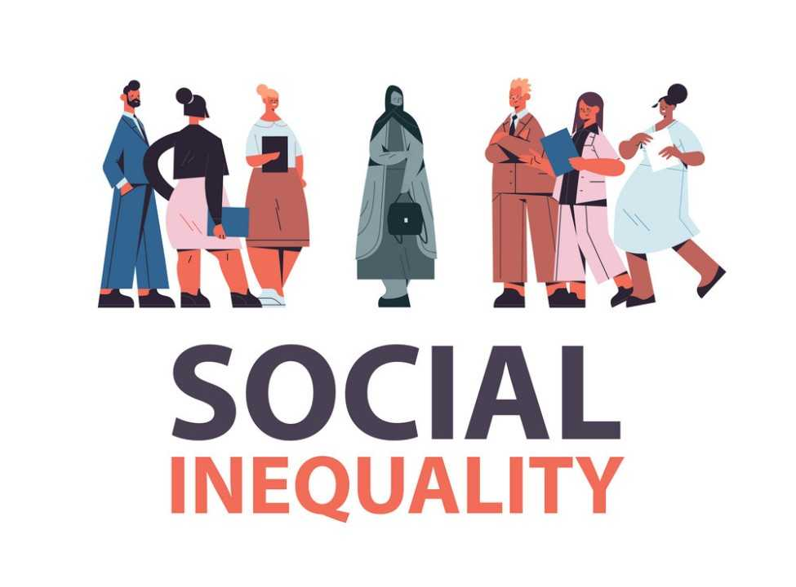

Slide 4

The condition where people have unequal access to valued resources, services and positions in society.
E.g., racial inequality, wealth inequality, gender inequality, judicial treatment, educational inequality.
Notes:
https://ecampusontario.pressbooks.pub/sociologymohawkcollege/chapter/chapter-9-social-inequality-in-canada/

Slide 5
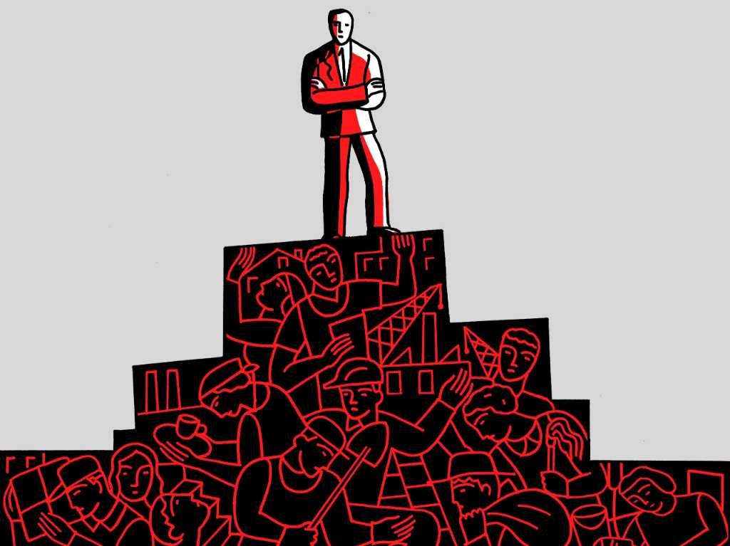
Social Stratification

Slide 6
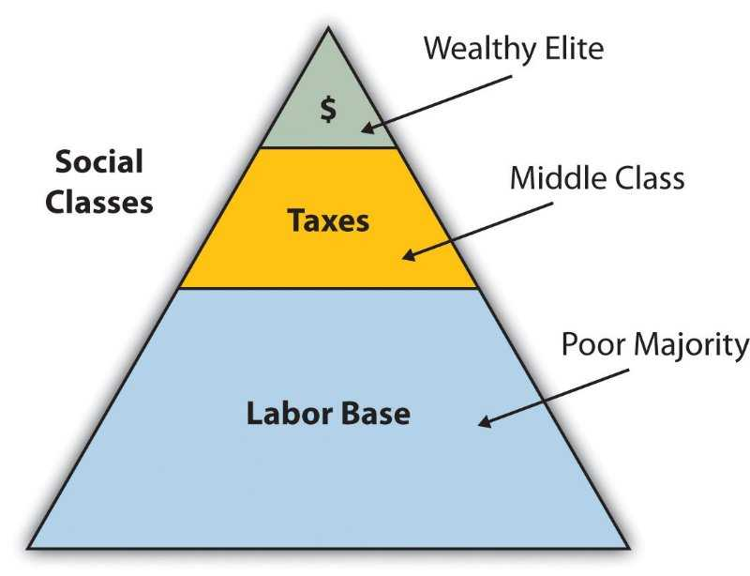
Sociologists use the term social stratification to describe the system of social standing.
Social stratification is a system in which groups of people are divided into layers according to their relative property, power, and prestige - a social hierarchy where classification is based on the wealth, occupation, education level, race, or gender.
Implications include unequal access to resources, power, and opportunities. It can perpetuate social inequalities, affect social cohesion, and limit mobility, potentially leading to social tension and conflict.
Economic status, racial and ethnic stratification, gender stratification, age stratification, educational stratification, caste system, religious stratification.
Notes:
https://openstax.org/books/introduction-sociology-3e/pages/9-1-what-is-social-stratification

Slide 7
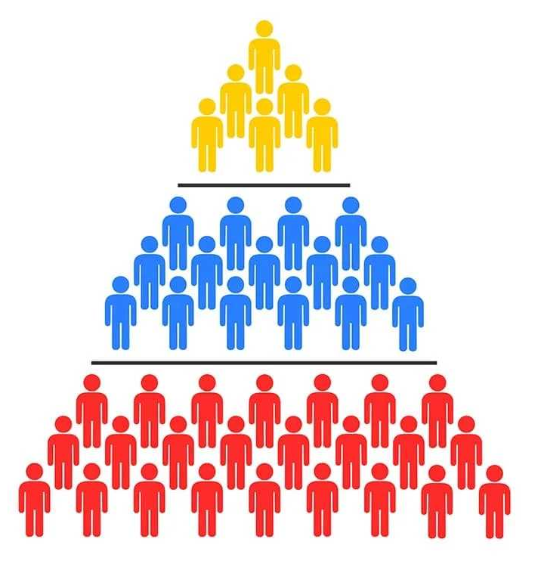
Major Systems of Social Stratification
Four major systems of social stratification:
1. Slavery
2. Caste
3. Estate
4. Class

Slide 8
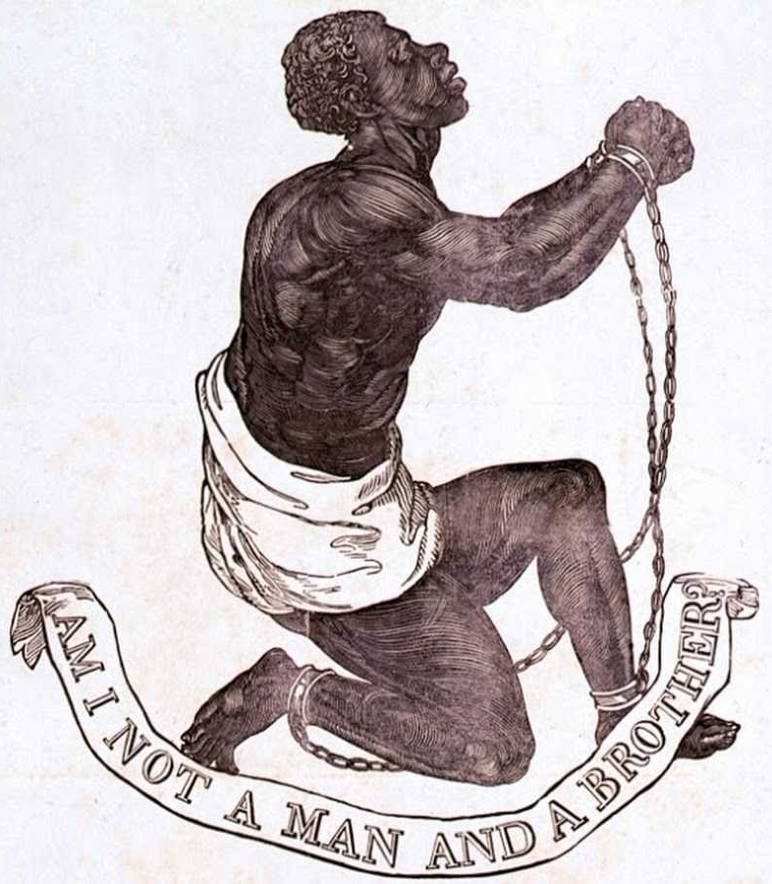
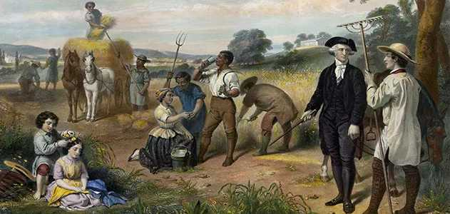
1. Slavery
Slavery’s essential characteristic is that some individuals own other people.
It has been common throughout history.

Slide 9
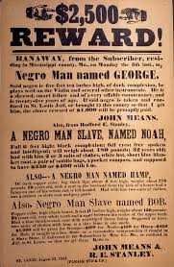
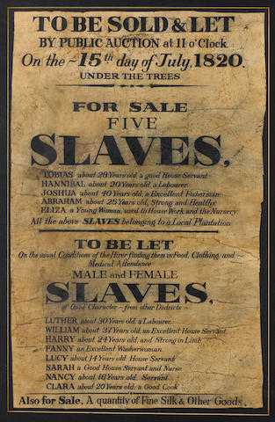
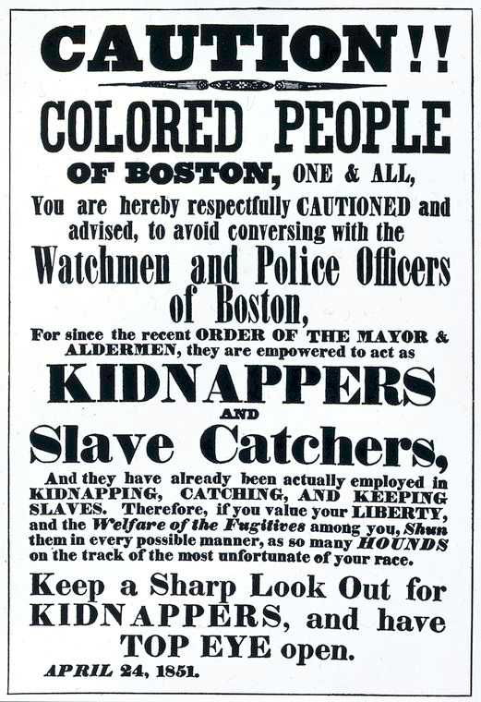

Slide 10
Causes of Slavery
Debt
Crime
War
In some societies, creditors would enslave people who could not pay their debts.
Instead of being killed, a murderer or thief might be enslaved by the victim’s family as compensation for their loss.
When one group of people conquered another, they often enslaved some of the vanquished.

Slide 11
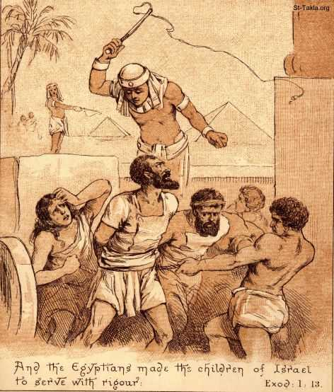
Conditions of Slavery
1. The conditions of slavery have varied widely around the world. In some places, slavery was temporary. Roman slaves ordinarily had the right to buy themselves out of slavery.
2. Slavery was not necessarily inheritable. Slaves of rich people were adopted by the family.
3. Slaves were not necessarily powerless and poor.

Slide 12

Indentured Servitude (Bonded Labor)
Indentured servitude is a form of labor in which a person is contracted to work without salary for a specific number of years. May be entered "voluntarily" for supposed compensation or debt repay.
Designed to exploit workers. Most common in India, Pakistan, Bangladesh and Nepal. In fact, the majority of the world’s slaves live and work in India in a form of bonded labor.

Slide 13
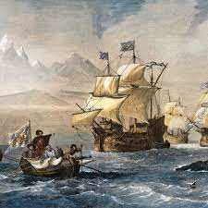
Slavery in New World
1. Because slavery has a broad range of causes, some analysts conclude that racism didn’t lead to slavery but, rather, that slavery led to racism.
2. People who wanted to start a new life in the American colonies but could not pay for their passage across the ocean would arrange for a ship captain to transport them on credit.
3. With time, colonists then turned to Africans, who were being brought to North and South America by the Dutch, English, Portuguese, and Spanish.

Slide 14
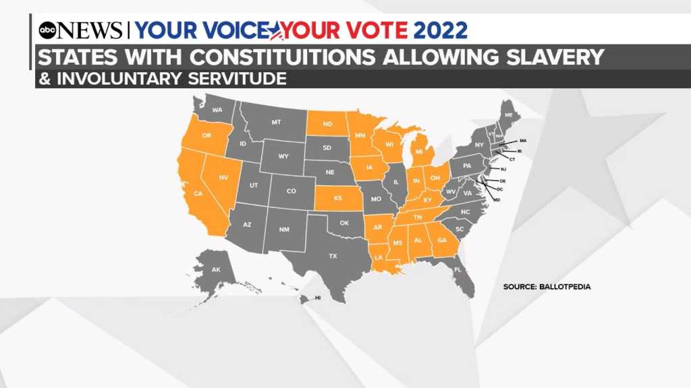
To defend slavery, U.S. slave owners developed an ideology, beliefs that justify social arrangements, making those arrangements seem necessary and fair.
They developed the view that their slaves were inferior. Some even said that they were not fully human. In short, the colonists wove elaborate justifications for slavery, built on the presumed superiority of their own group.
To make slavery even more profitable, slave states passed laws that made slavery inheritable; that is, the babies born to slaves became the property of the slave owners .
Black people weren’t allowed to sit on the same car.

Slide 15
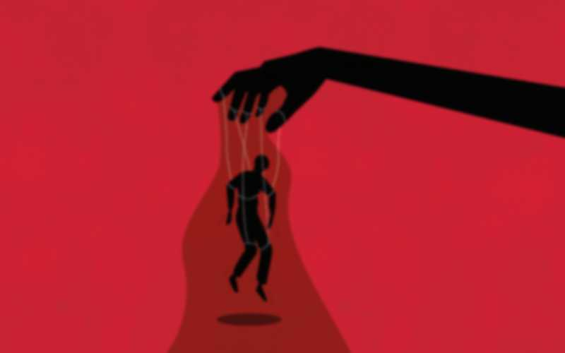
Slavery in Modern World
Modern slavery is an umbrella term which refers to situations of exploitation in which a person cannot refuse or leave because of threats, violence, coercion, deception, or abuse of power.
Globally comprises of two elements: Forced Labor and Forced Marriages. Example: Child Sex Trafficking, Human Trafficking.
WHY IT STILL EXISTS?
In some regions, ongoing conflict, political instability, and forced displacement are key drivers of modern slavery.
Transformations in the world of work, climate change, and migration increase the vulnerability of many people to exploit others.
Notes:
https://cdn.walkfree.org/content/uploads/2022/09/12142341/GEMS-2022_Report_EN_V8.pdf

Slide 16
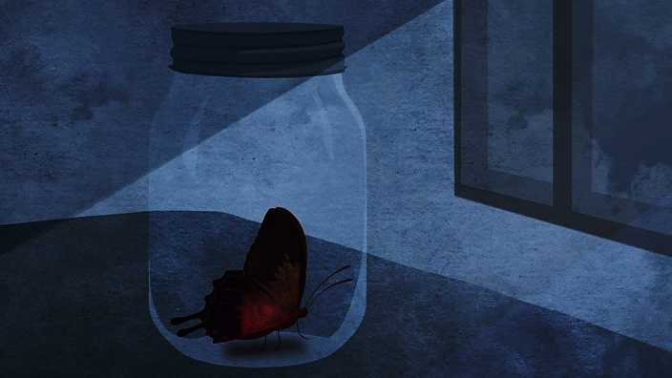
HUMAN TRAFFICKING
Defined by the UN Trafficking in Persons Protocol as involving recruitment, transportation, transfer, harbouring, or receipt of persons by means of threat or use of force or other forms of coercion with the intent of exploiting that person for sexual exploitation, forced labour, or slavery, among others forms.
DEBT BONDAGE
Status or condition where one person has pledged their labour or services (or that of someone under their control), in circumstances where the fair value of that labour or service is not reasonably applied to reducing the debt or length of debt, or the length and nature of the service is not limited or defined.
SLAVERY AND SLAVERY-LIKE PRACTICES
the status or condition of a person over whom any or all of the powers attaching to the right of ownership are exercised. There are also certain “slavery-like practices”: debt bondage, forced or servile marriage, sale or exploitation of children (including in armed conflict), and descent-based slavery.
FORCED MARRIAGE
Any situation where persons, regardless of age, have been forced to marry without their consent.
FORCED LABOUR
All work or service that is conducted under menace of penalty and for which the person has not offered themselves voluntarily.

Slide 17
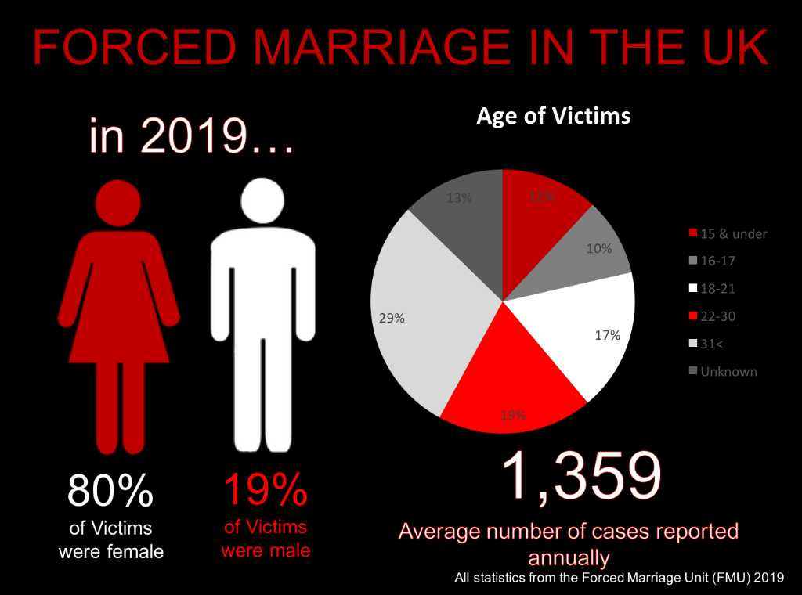

Slide 18
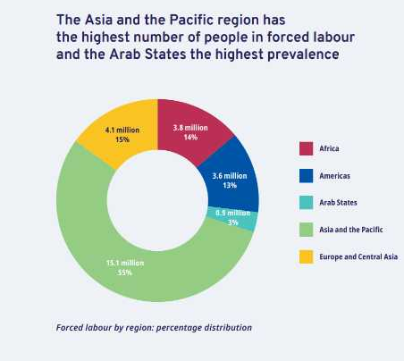
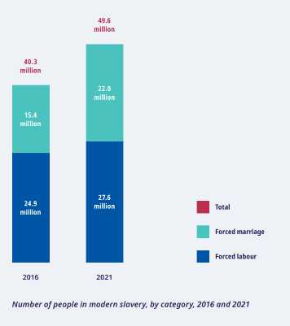

Slide 19
Slavery in Pakistan (Handout)
1. Bonded Labour
2. Child labour and trafficking
3. Forced Marriage
4. Human Trafficking
5. Commercial Sexual Exploitation
Victims: Poor, landless families; women in debt bondage; poor and illiterate women and children.
Victims Widespread, women; young women and adolescent girls.
Victims of domestic violence; families in debt bondage; Poor families; runaways; victims of forced marriages.
Men and women going for overseas employment. Poor and illiterate women and children from large families
Victims of domestic violence; women in forced marriages; victims of fake marriages; transwomen. Street children, nomadic and LGBTQI+ boys.

Slide 20
2. Caste
The second system of social stratification is caste. In a caste system, birth determines status, which is lifelong.
Caste systems separate groups of people based on their ancestry. They often restrict people to certain professions or who they can marry based upon ancestral lines or ethnicity.
Examples:
Indian Varnas (India), Tamil Castes (Sri Lanka), Moorish Castes (North Africa), Edo Society (Japan)
Common Features
Endogamy (marrying within caste)
Profession (assigned jobs for castes)
Social Status (castes sit on hierarchy)
Political exclusion of castes
Caste-based discrimination

Slide 21
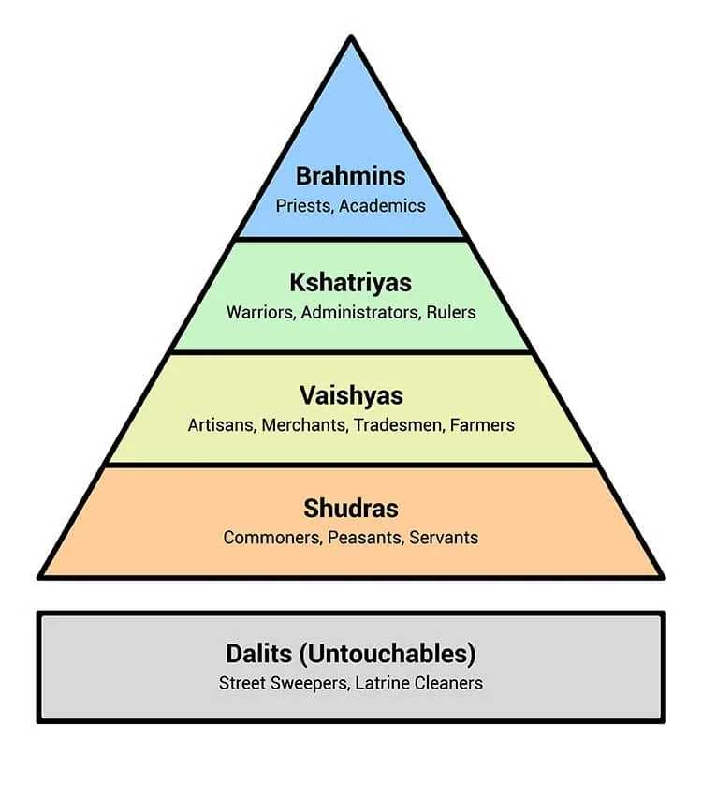
India provides the best example of a caste system. The Indian government formally abolished the caste system in 1949. However, these centuries-old practices continue, and the caste system remains part of everyday life in India.
Slowly, the caste system is giving way, being replaced by a social class system based on material wealth.
Endogamy
practice of marrying people within their own group, prohibiting the marriage of members of different castes.

Slide 22
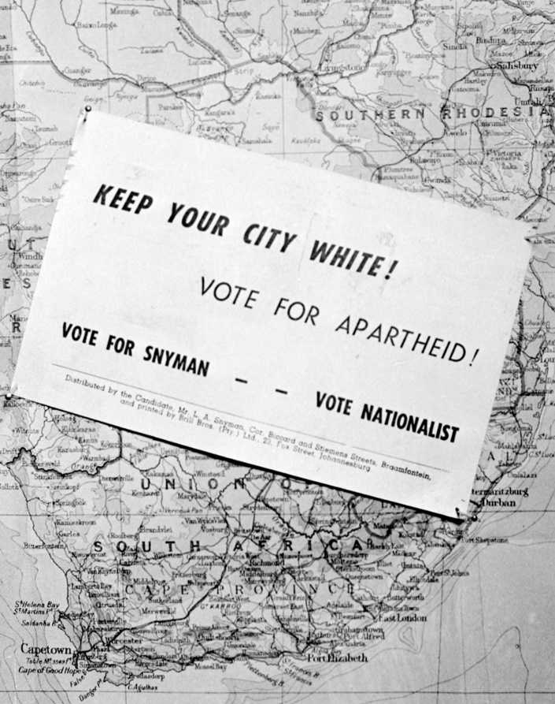
Caste system in Africa
Apartheid: The government-approved-and-enforced separation of racial–ethnic groups as was practiced in South Africa. “The separation of the races.”
Everyone was classified by law into one of four groups: Europeans (whites) Africans (blacks), Colored (mixed races), and Asians. These classifications determined where people could live, work, and go to school.
In 1994, Nelson Mandela, a black, was elected president. Black Africans no longer have to carry special passes, public facilities are integrated, and all racial–ethnic groups have the right to vote and to hold office.

Slide 23
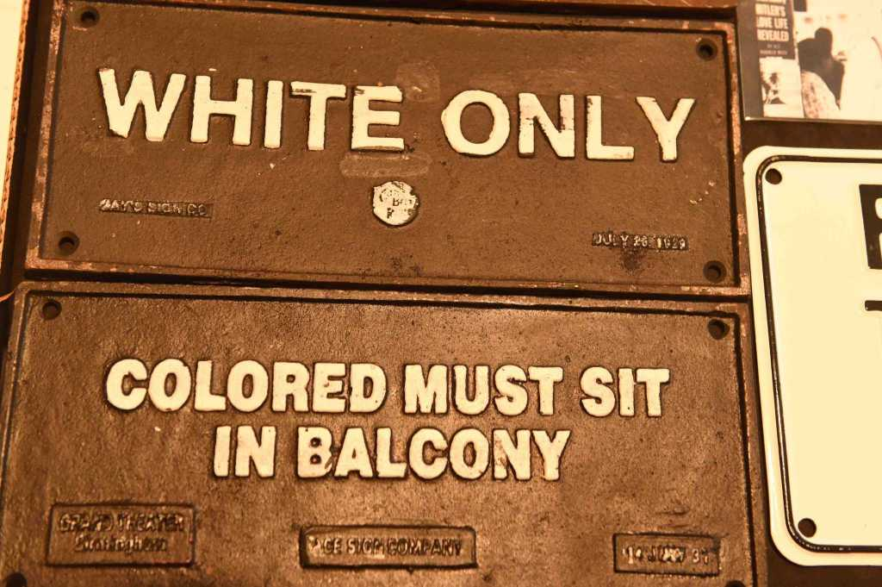
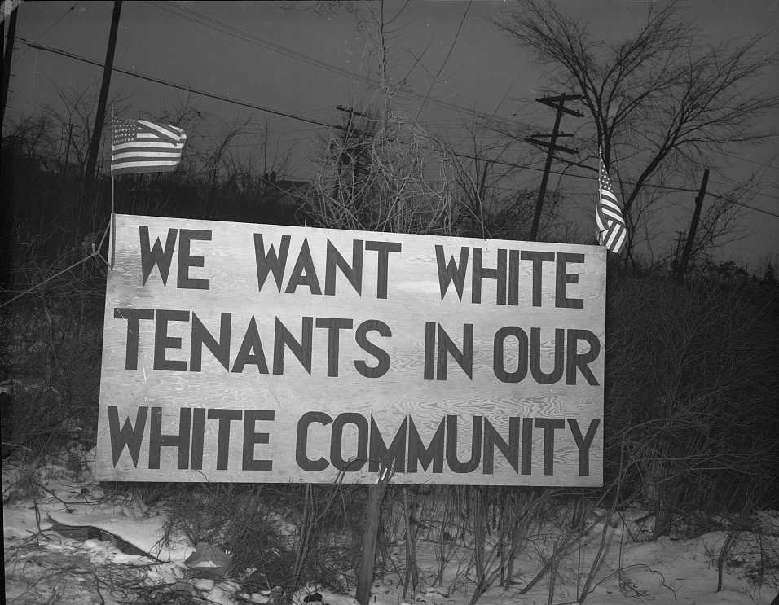
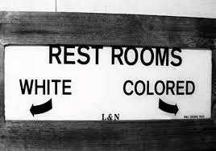
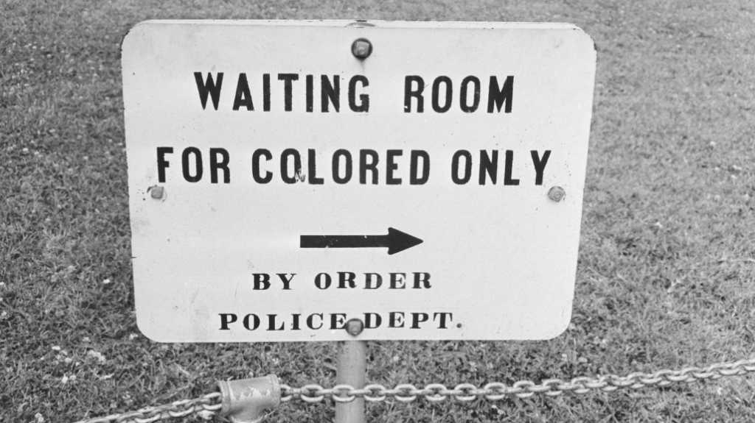
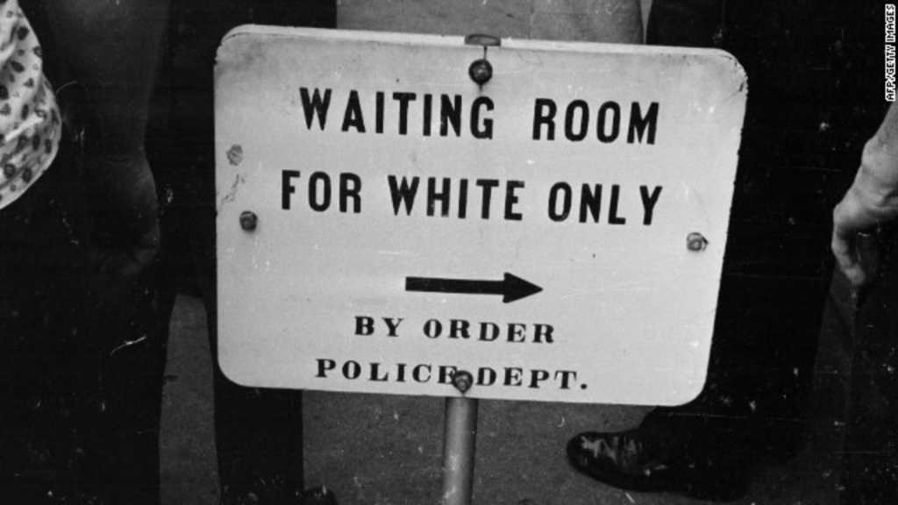

Slide 24
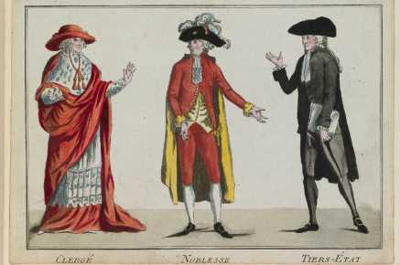
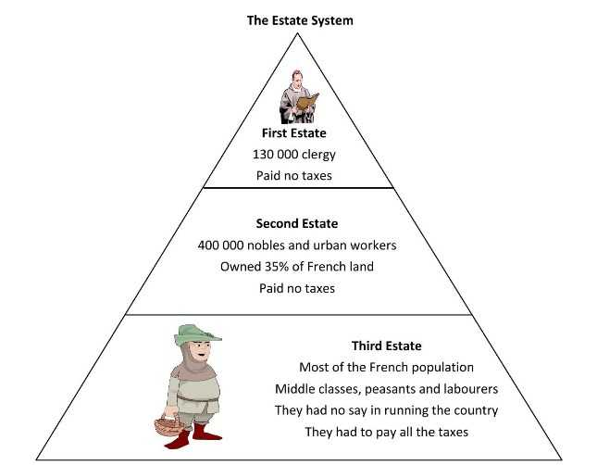
3. Estate
During the middle ages, Europe developed an estate stratification system. Form of feudal system.
1. Clergy (pray for all)
2. Nobility (to defend all)
3. Commoners (to provide food for all)
Notes:
https://greyhistory.com/french-revolution-articles/explained_the_three_estates_of_the_french_revolution/#:~:text=Summary%20of%20the%20Three%20Estates&text=The%20First%20Estate%20consisted%20of,french%20society%20(the%20commoners).

Slide 25
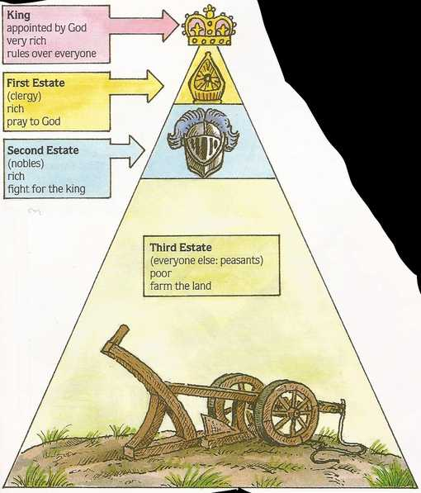
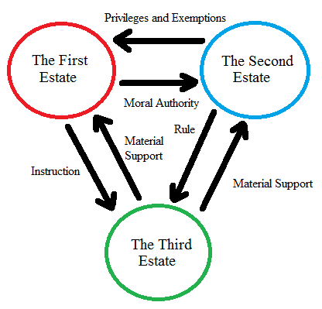

Slide 26
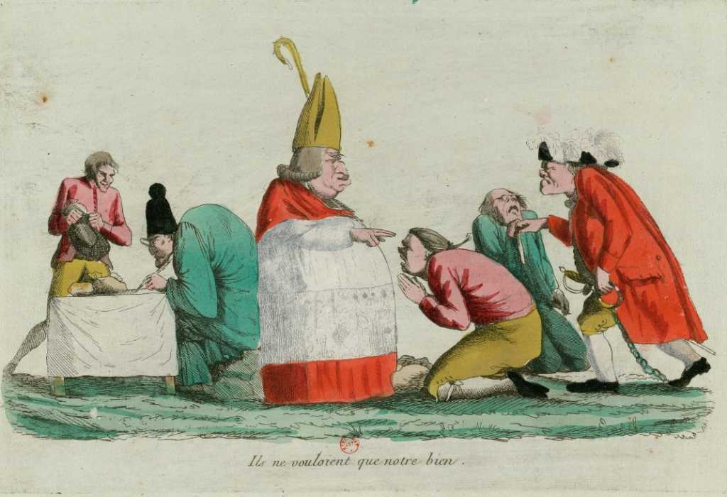
1. Clergy
The first estate consisted of the clergy.
The Roman Catholic Church was a political power at this time.
It also owned vast amounts of land and collected taxes from everyone who lived within the boundaries of a parish.
The church’s power was so great that in order to be crowned, kings had to obtain the pope’s permission.

Slide 27
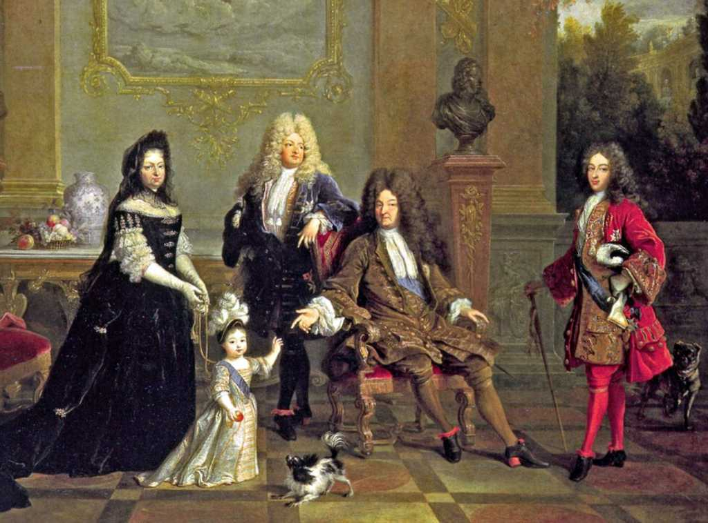
2. Nobility
The second estate was made up of the nobility, the wealthy families who ruled the country. This group owned the land, which was the source of wealth at that time. The nobility did no farming themselves, or any “work,” for that matter.
Work was considered beneath their dignity, something to be done by servants. The nobility’s responsibility was to administer their lands, to defend the king (and, in doing so, their own position).
Additionally, aristocrats enjoyed exclusive access to many government, religious, and military positions.

Slide 28
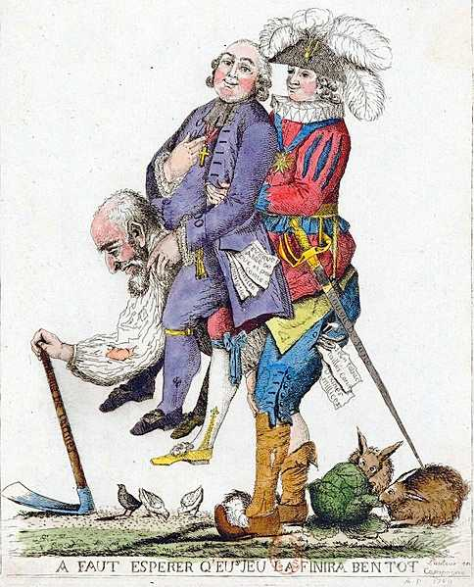
3. Commoners
Third Estate was composed of all commoners and was highly non-homogeneous in nature. This estate included wealthy merchants, educated bourgeoisie, skilled artisans, and illiterate.
The rare person who made it out of the third estate was either a man who was knighted for extraordinary bravery in battle or someone “called” into a religious vocation.

Slide 29
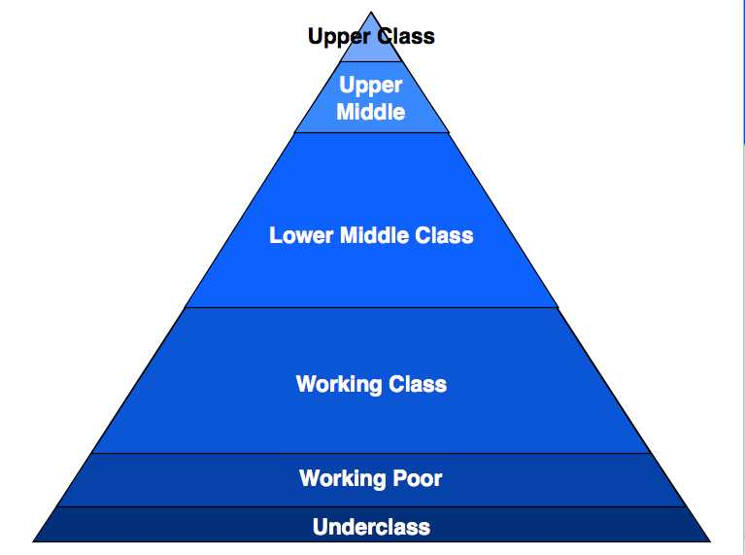
4. Class
It’s a form of social stratification based primarily on income, education, and prestige of occupation.
Class system allows social mobility, movement up or down the class ladder.
A class system, in contrast, is much more open, because it is based primarily on money or material possessions, which can be acquired.

Slide 30
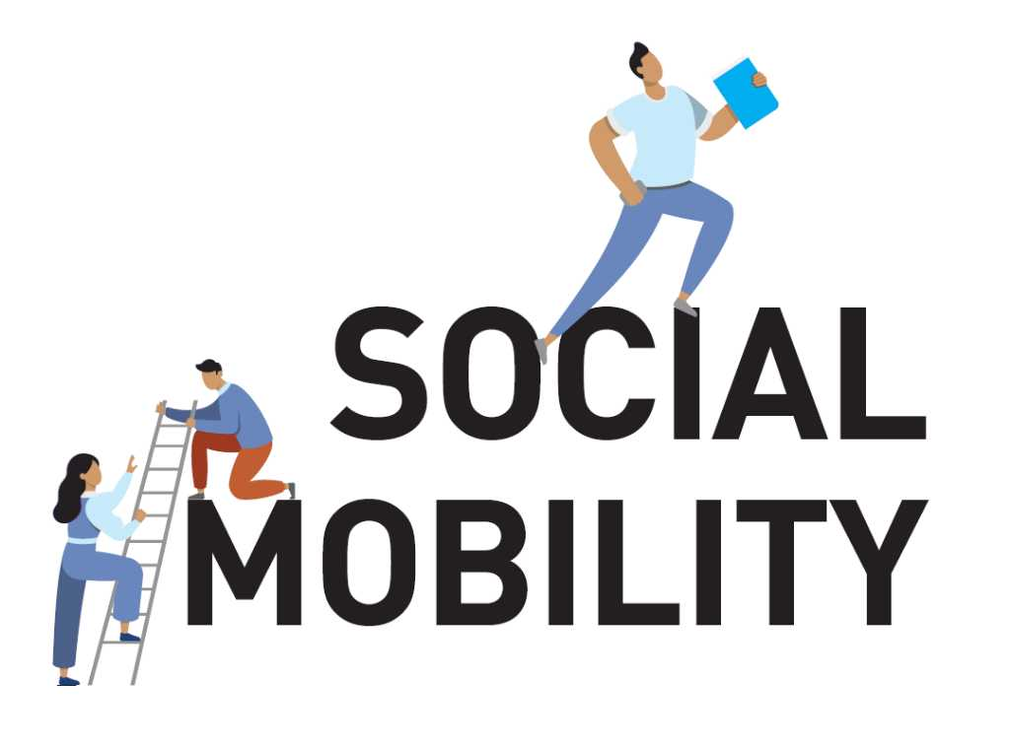

Slide 31
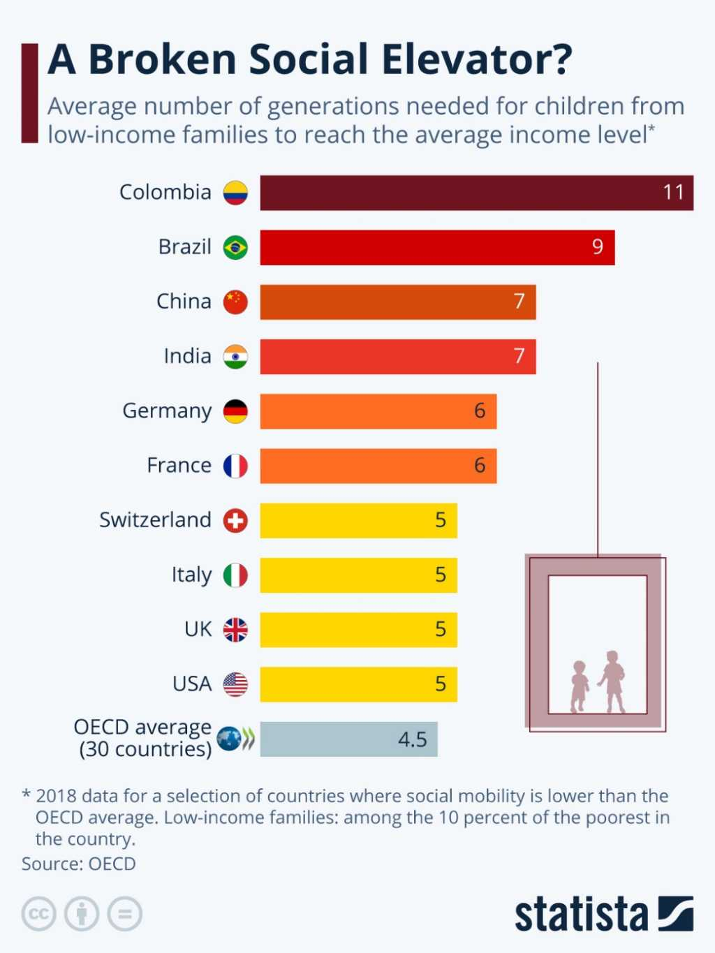
Social Mobility
The ability of individuals or groups to change their position within their society’s class structure during their lifetime.
It is the movement up or down the social class ladder. Refers to how a person’s social standing changes with time.
Notes:
https://www.slideshare.net/NagamaniManjunath/social-mobilitypptx

Slide 32
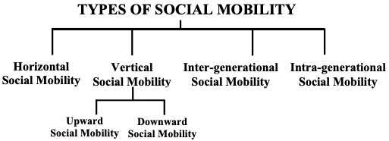

Slide 33
Types of Social Mobility
Intergenerational Mobility
the change that family members make in social class from one generation to the next.
Upward Social Mobility
movement down the social class ladder.
movement up the social class ladder.
Downward Social Mobility
Structural Mobility
movement up or down the social class ladder that is due more to changes in the structure of society than to the actions of individuals.

Slide 34
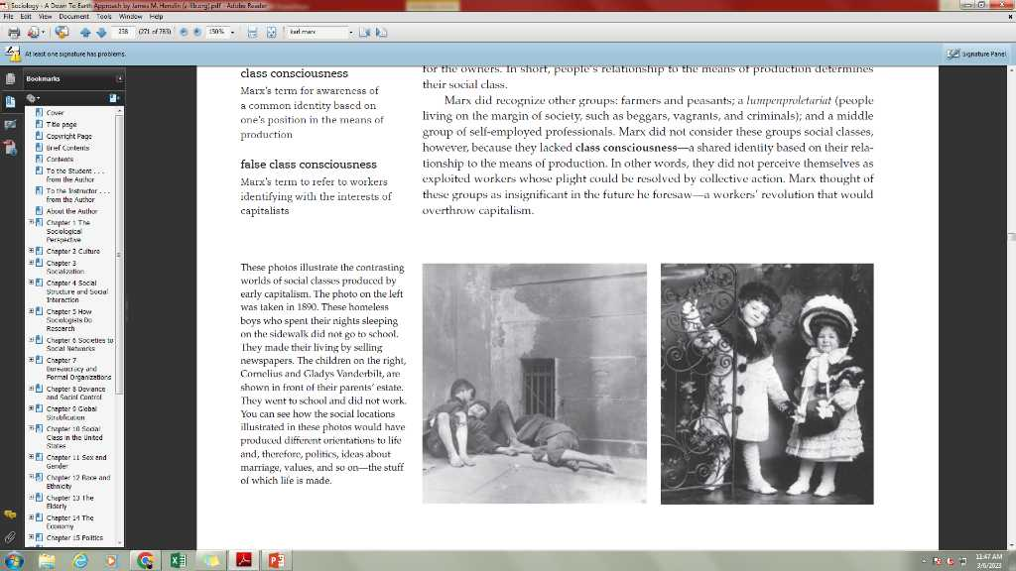
Theoretical perspectives on Social Stratification
Karl Marx argued that a single factor determines social class: If you own the means of production, you belong to the bourgeoisie; if you do not, you are one of the proletariat.

Slide 35
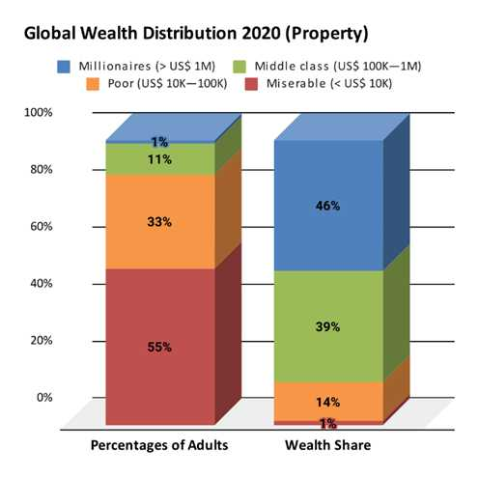

Slide 36
False Class Consciousness
For example, workers with a few dollars in the bank may forget that they are workers and instead see themselves as investors, or as capitalists who are about to launch a successful business.
A Marxist concept that suggests that the proletariat (working class) do not recognise that they are being exploited by the bourgeoisie (ruling class) and indeed contribute to their own exploitation.
Workers mistakenly thinking of themselves as capitalists. Hold values and beliefs that benefit the ruling class, and do not understand that they are being exploited.
Mass media play an important role in ensuring that the working class remain happy with their situation despite the inherent unfairness of the system.
Notes:
243

Slide 37
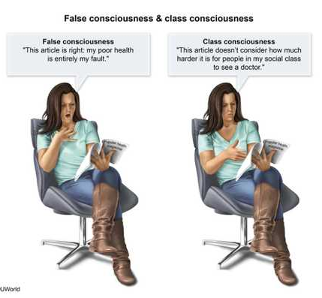

Slide 38
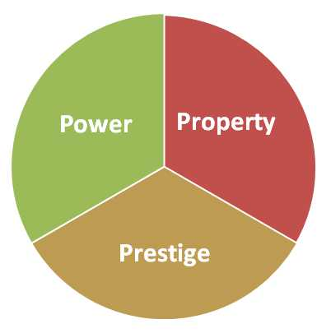
Max Weber: Property, Power, and Prestige
Weber argued that property is only part of the picture. Social class, he said, has three components: property, power, and prestige.
1. Power, is the ability to control others, even over their objections.
3. Prestige, the third element in Weber’s analysis, is often derived from property and power, since people tend to admire the wealthy and powerful.
2. Property (or wealth), said Weber, is certainly significant in determining a person’s standing in society.

Slide 39
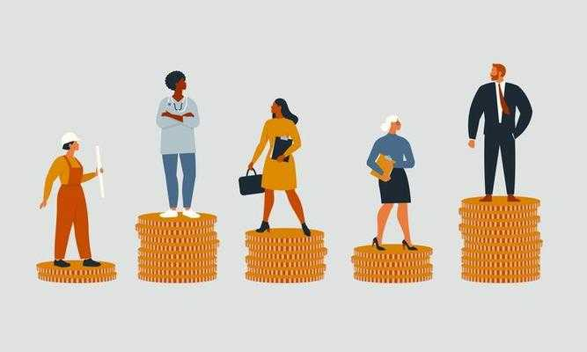
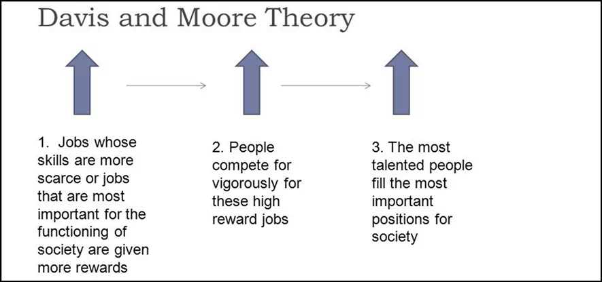
Why inequality is universal?
Wilbert Moore concluded that stratification of society is inevitable because:
1. For society to function, its positions must be filled.
2. Some positions are more important than others.
3. The more important positions must be filled by the more qualified people.
4. To motivate the more qualified people to fill these positions, they must offer greater rewards.

Slide 40

The Conflict Perspective
Class Conflict and Scarce Resources: (Mosca’s Argument) Italian sociologist Gaetano Mosca argued that every society will be stratified by power. This is inevitable, he said in an 1896 book titled The Ruling Class, because:
1. No society can exist unless it is organized. This requires leadership to coordinate people’s actions.
2. Leadership requires inequalities of power. By definition, some people lead, while others follow.
3. Because human nature is self-centered, people in power will use their positions to seize greater rewards for themselves.

Slide 41

Current Applications of Conflict Theory
They examine how groups within the same class compete with one another for a larger slice of the pie (Collins 1999; King et al.2010).
Even within the same industry, for example, union will fight against union for higher salaries, shorter hours, and more power. Another focus of conflict theorists is conflict between racial–ethnic groups as they compete for education, housing, and even prestige—whatever rewards society has to offer.
They also study the relations between women and men, which conflict theorists say are best understood as a conflict over power—over who controls society’s resource.

Slide 42
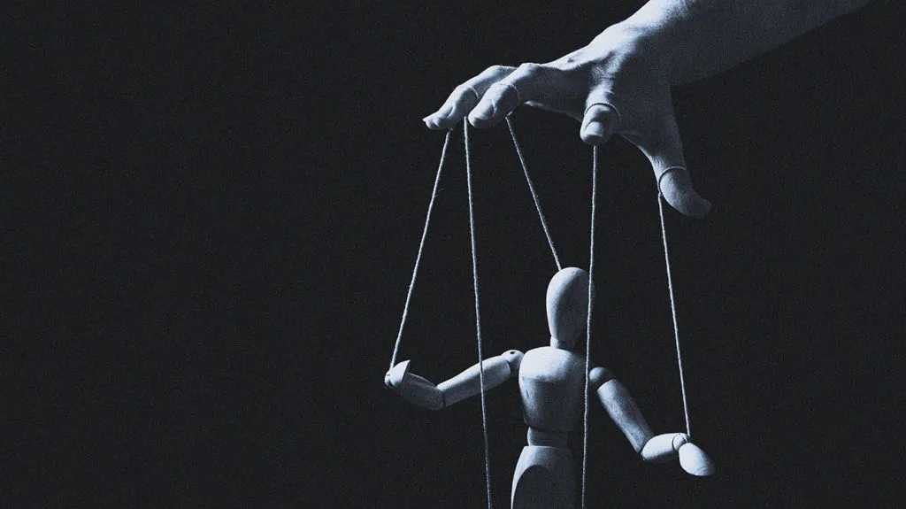
How Do Elites Maintain Stratification?
Controlling People’s Ideas
Controlling Information
Stifling Criticism
Big Brother Technology

